Slide 1

Immune Cell Classification and Detection Project
Using YOLOv8 and Fastai
Aharon Cooper
2024

Slide 2
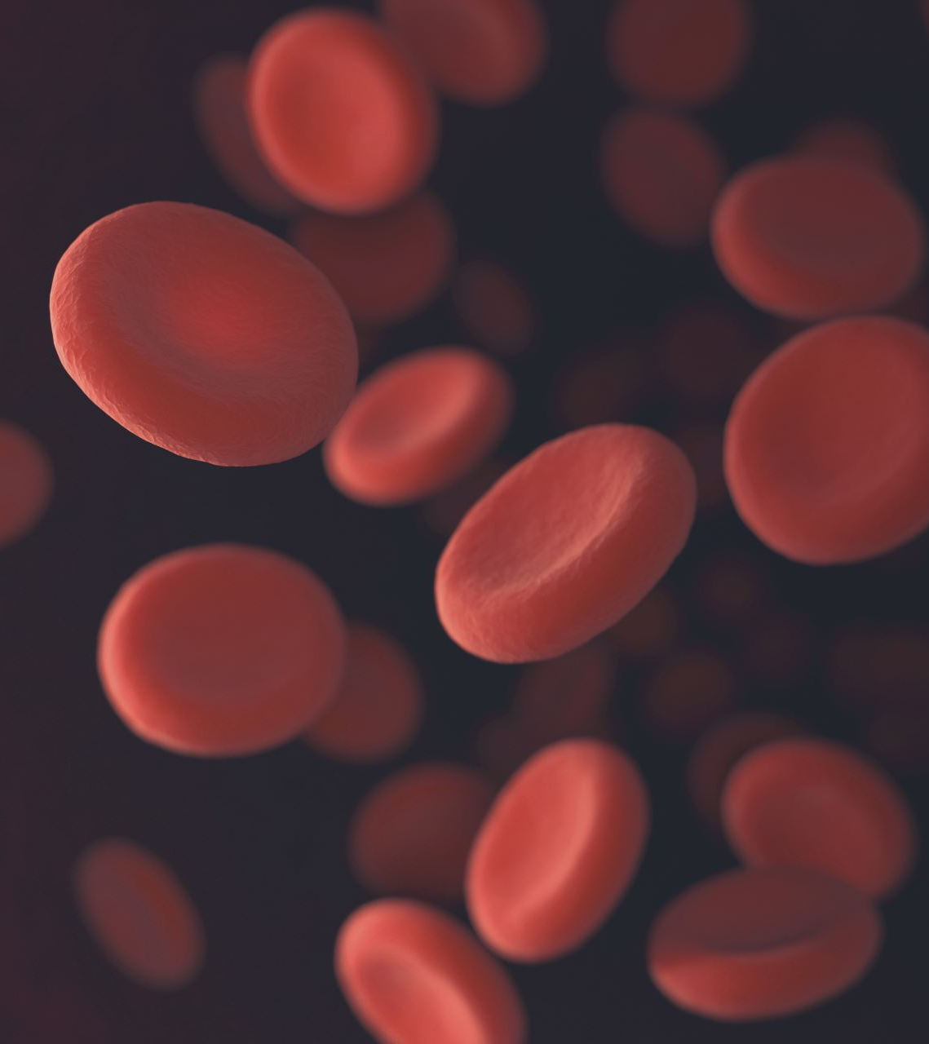
Project Overview
Content:
Goal: Automate identification and classification of white blood cells (WBCs).
Methods: YOLOv8 for detection, Fastai with ResNet for classification.
Categories:
Basophils, Eosinophils, Lymphocytes, Monocytes, Neutrophils.
Applications: Supports hematology/immunology research and assists in diagnostics.

Slide 3
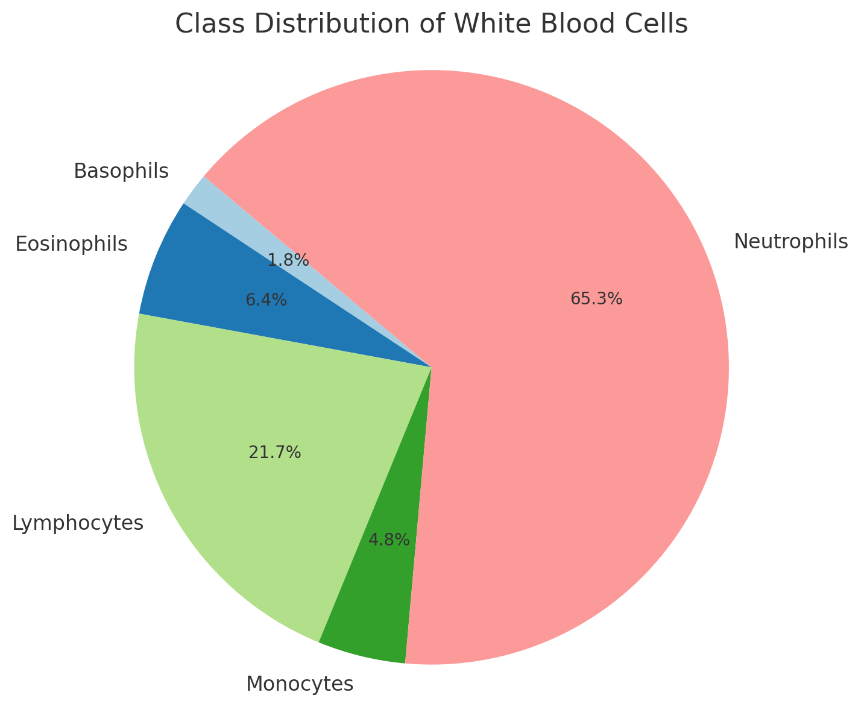
Dataset
Structure:
Train, Validation, Test (organized by class).
Class Distribution:
Basophils: 301 | Eosinophils: 1,066
Lymphocytes: 3,609 | Monocytes: 795 | Neutrophils: 10,862

Slide 4
Tools Used
Frameworks & Libraries:
Fastai (Classification)
YOLOv8 by Ultralytics (Detection)
PyTorch
Platforms:
Google Colab
Kaggle (Dataset Management)
Tracking & Logging:
Weights & Biases (W&B)
Other Tools:
Streamlit (Web Interface)
Hugging Face (Model Hosting)
GitHub (Project Repository)

Slide 5
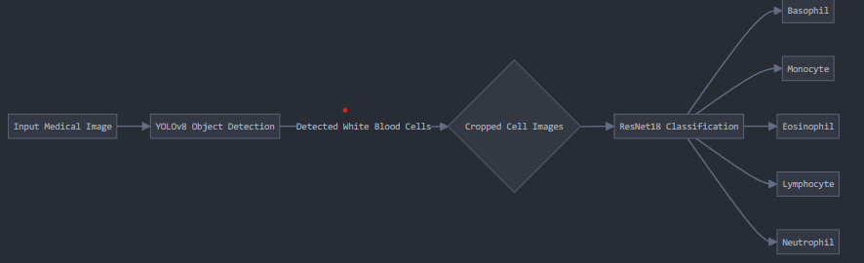
Model Architecture
YOLOv8 for Detection:
Detects white blood cells and generates bounding boxes.
Fastai for Classification:
Classifies detected cells into 5 categories.
Features:
Data Augmentation
Cross-Entropy Loss
Metrics: Accuracy, Precision, Recall, F1-score.

Slide 6
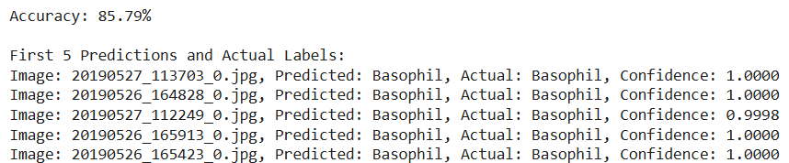
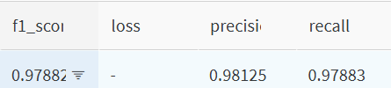
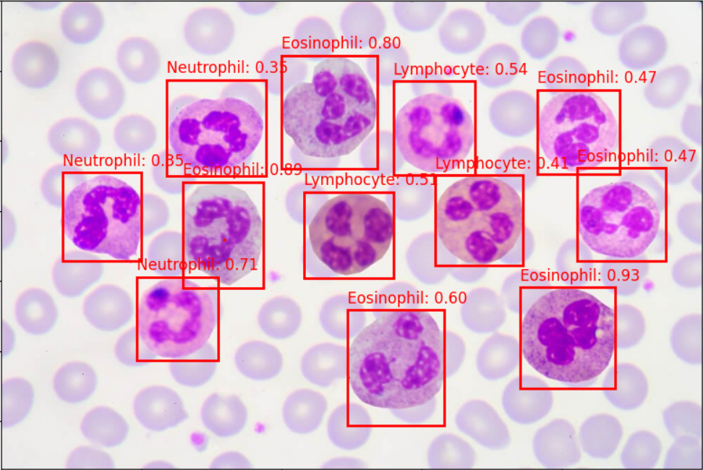
Results
Accuracy: 85.79% on the test dataset.
Class-wise Metrics: Precision, Recall, F1-Score (tracked in W&B).
YOLOv8: Accurate bounding boxes for WBC detection.

Slide 7

Challenges and Future Work
Challenges:
Class imbalance (e.g., fewer Basophil images).
Need for extensive labeled datasets.
Future Work:
Extend dataset for better class balance.
Explore Vision Transformers or ensemble methods.

Slide 8
Conclusions and Acknowledgments
Conclusion:
Successfully built a pipeline for detection and classification of WBCs.
Achieved strong performance (85.79% accuracy).
Acknowledgments:
Thanks to Aviad Rozenhek for mentoring me through this project

